Slide 1
Heaps and Priority Queues
CS 240 Spring 2019

Slide 2
Problem
Assume you are looking for a job, and you have been given job offers from 50 different companies. Each company wants you to come and do an onsite visit, whenever you would like, but you must decide if you will take the job immediately upon concluding the visit. How would you sort which companies you would visit first?

Slide 3
Priority Queue
What if we want to access data similar to a stack or queue, but organized by importance or priority
we call this a priority queue.
Instead of being a "First In First Out" or “Last In First Out”, values come out in order by priority.
Like a Stack or Queue, you only ever access one element at a time

Slide 4
Problem
Let’s put our job offers into data structures we’ve seen so far
Using an Array
sorted order makes insert slow, removePriority fast
arbitrary order makes insert fast, removePriority slow
Using a Linked List
Sorted makes insert O(n)= cn (linear)
Unsorted makes removePriority O(n)= cn (linear)
Using a BST
removePriority is O(logn) IF the tree stays balanced
If the tree is not balanced, insert and removePriority can be O(N).

Slide 5
Balanced and Complete Trees
Full Tree
A full binary tree is a tree in which every node other than the leaves has two children. There are no single node parents.
Balanced Tree
The tree’s height is such that no leaf is more than one level away from any other leaf in the tree
Complete Tree
A tree in which every level, except the last, is filled, and all nodes are as far left as possible.

Slide 6
Solution
A balanced BST will give the best performance for a priority queue
More Problems:
Read Priority operation still has to traverse the left branch
Make read constant time by making the priority value the root
BST structure uses strict ordering
All values can only go one place which makes keeping the tree balanced difficult

Slide 7
A tree that isn’t a BST
We need a data structure that allows:
partial ordering
always has the priority value as the root
A Heap is:
a complete binary tree
nearly always implemented using the array representation
The values in the tree maintain a parent/child relationship only.
No defined relationship with the tree as a whole
This is called partial order

Slide 8
Array Based Tree
Mapping elements of a tree into an array
if a node is stored at index k
the left child is at index 2k+1
The right child is at index 2k+2
The parent is (k-1)//2 #integer division
Assertion: Maintaining a balanced tree is easier with an array based implementation.
Agree?
Don’t confuse the logical representation of a heap (tree) with its implementation (array).
Notes:
Can iteratively search through the tree for empty indexes

Slide 9
Heap Variants
There are two variants of the heap
In a max heap, every node stores a value that is greater than or equal to the value its children.
Because the root has a value greater than or equal to its children, which have values greater than or equal to their children, the root stores the maximum of all values in the tree.
In a min heap, every node stores a value that is less than or equal to that of its children.

Slide 10
Node Relationships
There is no relationship between the value of a node and that of its sibling in a heap
For example, the values for all nodes in the left subtree of the root could be greater than the values for every node of the right subtree.
This is a feature, not a bug
Contrast with a BST which has a strict ordering relationship

Slide 11
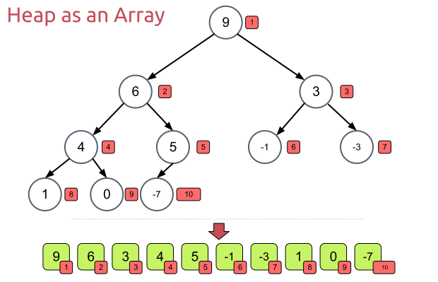
Creating A Heap
Given an array of N values, a heap can be built by “sifting” each node down to its proper place
Any array can be made into a heap using the ‘Heapify’ sorting algorithm

Slide 12
Where to Start?
9
Start with the last internal node
How do we find the last internal node (non-leaf)?
Take the last index, then find parent: (i-1)//2
Swap the current internal node with its smaller child, if necessary
6
3
4
5
-1
-3
1
0
-7

Slide 13
Sift Down
Follow the swapped node down the tree until both children are larger
9
9
6
3
6
3
4
5
-1
-3
4
-7
-1
-3
1
0
-7
1
0
5

Slide 14
Sift Down
Go to the next internal node. Repeat until all internal nodes are done
Check both children for the smaller value, swap with the smaller node
9
9
6
3
6
3
4
-7
-1
-3
0
-7
-1
-3
1
0
5
1
4
5

Slide 15
Classwork
From BSTs to Heaps

Slide 16
the Heap Instance Variables
// Min-heap implementation class MinHeap{ private: Comparable * heap; //Pointer to an array of comparables int n; // Number of things now in heap
int max; //maximum size of the heap
…
If you use an STL container, such as a vector, that would be all you need for private instance variables

Slide 17
Constructing the Heap
//Constructor supporting preloading of heap contents
MinHeap(Comparable * h, int num, int max){ Heap = h; n = num; size = max; buildheap(); //creates the heap data structure }

Slide 18
Constructing an Array Based heap
Though not required, you should have methods that return pointers to or indexes of parents and children
int left(i){ if(2i + 1 > n) return -1; else return 2i + 1; }

Slide 19
Heapify
//Heapify the array elements
void buildheap(){ for (int i=(n-2)/2; i>=0; i--) siftdown(i); }
Why is ‘i’ initalized like this?
Because n is 1 more than the last index of the array
Buildheap will run through (almost) every element of the array
O(n) to heapify

Slide 20
SiftDown
// Put element in its correct place
void siftdown(int pos) { if ((pos < 0) || (pos >= n)) return; // Illegal position while (!isLeaf(pos)){ //Keep swapping until you get to a leaf int j = left(pos); //Get left child if ((j+1 < n && (heap[j] > heap[j+1])) j++; // j is now index of child with greater priority if (heap[pos] < heap[j]) return; //pos is in correct position swap(heap[pos], heap[j]); pos = j; // Move down } }

Slide 21
Cost of SiftDown
In a complete binary tree of N nodes, the number of levels is at most 1 + log(N).
Each non-terminating iteration of the loop moves the target value a distance of 1 level, the loop will perform no more than log(N) iterations.
Thus, the worst case cost of SiftDown() is O(logn)

Slide 22
Total Cost of Building a Heap
Suppose we start with a complete binary tree with N nodes
The max number of steps required for sifting values is N = 2d-1 for some integer d = log N.
In the worst case, the number of swaps BuildHeap() will require in building a heap of N nodes is N-logN
So we can say building a heap costs T(n) = cn

Slide 23
Removing the Priority Value
What happens when we remove the priority value?
The priority value is stored at the root
Choose the last leaf to replace the root, then sift down
Why choose the last leaf?
Comparable removePriority(){
//Check for empty heap
if (numVertices == 0)
return ;
//Swap the root with last leaf
Comparable priority = heap[0];
heap[0] = heap[n - 1]; heap[n - 1] = priority;
//shrink heap by one node n--;
//sift new root down
siftDown(0);
return priority;
}
Notes:
Choosing the last leaf allows you to call siftDown which only requires logn swaps. Choosing another node would require you to call sift down on it and all it’s children.
Choosing the last node guarantees it is a leaf node.

Slide 24
Classwork
isHeap()

Slide 25
Classwork
Balanced vs Complete

